Slide 1
NAME-Sujal Kishor gamare class- sybsc-pc prn no- 2021420295 physics project paper-1

Slide 2
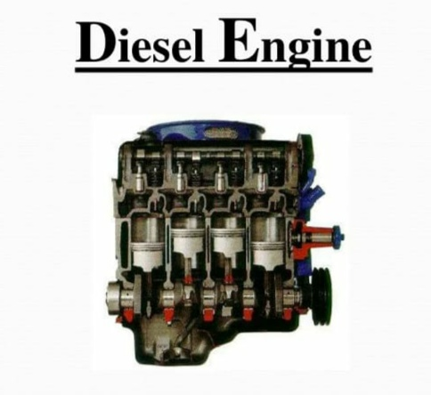
iNTRODUCTION
DIESEL ENGINe
The diesel engine, named after RUDOLF DIESEL, It is an internal combustion process of a type of engine in which the burning of fuel is triggered by heat generated in compressing fuel.
FOUR PARTS –
Suction Stroke
Compression Stroke
Working Stroke
Exhaust Stroke

Slide 3
SUCTION/INTAKE STROKE –
Suction stroke starts when piston is at top dead center
And about to move downwards. The inlet value is open
At this time and the exhaust valve is closed.
Due to the suction created by the motion of piston
towards the motion BDC, Air alone is inducted duri-
ng the Suction Stroke.
COMPRESSION STROKE –
In compression stroke, Once piston reaches BDC & moves
Back TDC, inlet valve will be closed. As the piston moves
towards TDC. It compress air inside the cylinder.
Compression takes place hence it is called
compression stroke.

Slide 4
POWER STROKE –
In power stroke, Both the valves are closed. When
Piston reaches top of its stroke. The fuel is sprinkled by
The fuel injector and the fuel mixture is ignited.
High temperature & pressure generated inside the
cylinder & push down the piston to BDC. Hence it
known as power or expansion stroke.
EXHAUST STROKE –
In this stroke exhaust valve is opened when piston reaches
To BDC & moves to upward.
Piston pushes out the burnt gases to the atmosphere
through the exhaust valve. Hence called exhaust &
the engine is ready to begin the cycle again.

Slide 5
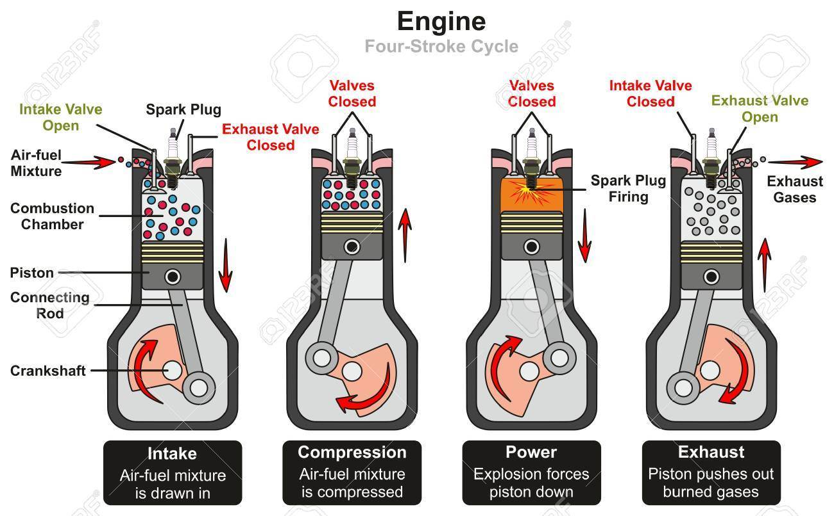
The four stroke diesel engine is an internal combustion engine in which the piston complete four separate stroke while operating one cycle.

Slide 6
ADVANTAGE & DISADVANTAGE OF DIESEL ENGINE
ADVANTAGE
Easy to manufacture & low cost.
Gives less torsional oscillation.
Requires less spare parts.
Easy for maintenance.
DISADVANTADE
High fuel consumption.
Consumers more lubricating oil.
More wear & tear of moving parts hence its gives loud noise.

Slide 7
Conclusion
When the piston reaches TDC at the end of end of the exhaust step, the cycle is Fully done. That mean, there are 4 process, suction step when piston moving down, compression step when piston moving up, burning step when piston moving down, the last in exhaust step when piston moving up, the final step is exhaust stroke piston will move down and it go to the next cycle.
THANK YOU

